Slide 1
How Number of Developers Influenced Size of OSS Projects
Vant149 Research Project
Kelvin Li & Lamont Zeng

Slide 2
Table of Contents
Introduction
Methods
Results
Discussion
Conclusion

Slide 3
Table of Contents
Introduction
Methods
Results
Discussion
Conclusion

Slide 4
Table of Contents
Introduction
Questions
Backgrounds
Rationale
Goal
Hypothesis
Methods
Results
Discussion
Conclusion

Slide 5
Questions
Have you written code before?
If you were in year one, have you taken CPSC courses?
Or, have you seen your friend who took CPSC courses struggling with their program for couple hours?
Thing can get a lot easier when a number of people are working on a same project together.
Notes:
If so,
You would know, if a program have too many functions can be difficult for a single person to finish it…
And that’s what programmers in real life do
If they have some idea or want to make a project,
They may upload their project at an online platform,
And if some one find it interesting, they may contribute to this project.

Slide 6
Backgrounds
number of Developers Influenced Size of OSS Projects
Developers: people who write code and program with computer
OSS: open source software, software whose source code are public.
Usually hosted on OSS communities, where multiple developers can work on a same project online.
OSS projects: usually a large program project.

Slide 7
Rationale
To help estimate the number of developers we need for a particular size of OSS project.

Slide 8
Goal
Build a program that could help us to quantitative model this relationship (# of developers & size of project)

Slide 9
Hypothesis
The number of developers and the size of projects have a positive correlation ( i.e. large projects would have more developers vice versa)

Slide 10
Table of Contents
Introduction
Methods
Results
Discussion
Conclusion

Slide 11
Table of Contents
Introduction
Methods
Program development
Analysis (I)
Analysis (II)
Results
Discussion
Conclusion
Notes:
Now I ‘m gonna talk about the methods we used in this research, in this study, we firstly develop a program for data collection and the we do data analysis

Slide 12
Program development
Step 1. Generate a tree structure
Step 2. Append projects belong to each user on the tree to a list
Step 3. Download all the projects
Step 4. Use command line script to gather info.
Notes:
Emm I am not going to introduce the technical details of the program, this is just a brief summarize.
For the first step, we Generate a tree structure of users. By using GitHub API
And in order to decrease our workload, we filter projects which have been created between Sep 2016 to Sep 2017 by every user on our user tree and append all these projects into a list
And then Download all the projects on the list and record their file size
In Then last step we Use command line to pull the number of developers involved in each project, and record them as well
And then do a cross tab using the data of file size and the number of developers

Slide 13
Analysis (I)
The logged number of developers were grouped into 17 groups:
1, 3, 6, 10, 15, 21, 28, 36, 45, 55, 65, 75, 85, 100, 130, 145, 190 and 190+
Then take the natural logarithm on the file sizes (for skewness)
Notes:
The file size of the projects (in kilobyte (kB)), were used natural logarithm on it in order to respond to skewness of large values.

Slide 14
Analysis(II)
Converting size of project (kB) to lines of code needs a coefficient:
This coefficient was set as follow:
80 characters
80 characters * 0.5 = 40 characters
1 kilobyte (kB) = 1024 characters
1024 characters / 40 characters = 25.6
=> Coefficient = 25.6 => estimated averagely 25.6 lines of code/kB
Notes:
In order to use the model in a more user friendly way , we cannot continue using the file size (in terms of KB), we need to convert the file size into lines of code, and in order to convert this, we need to setup a coefficient
First 80 characters, and why 80? Because most modern programming language requests programmers not to write more than 80 characters per line
But its difficult to fulfill the maximum amount of characters in every line, so we halved this number, by assuming 50%of codes were full 80 characters.

Slide 15
Table of Contents
Introduction
Method
Results
Discussion
Conclusion

Slide 17
Table of Contents
Introduction
Method
Result
Discussion
Conclusion

Slide 18
Table of Contents
Introduction
Method
Result
Discussion
Use this model for rough estimation
An example
Limitations(I)
Limitations(II)
Future improvements
Conclusion
Notes:
Now I’m gonna do the discussion, first I’m gonna talk about how to use this model to do a rough estimation, following an example will be presented, and then I’m gonna talk about the limitations and future improvements.

Slide 19
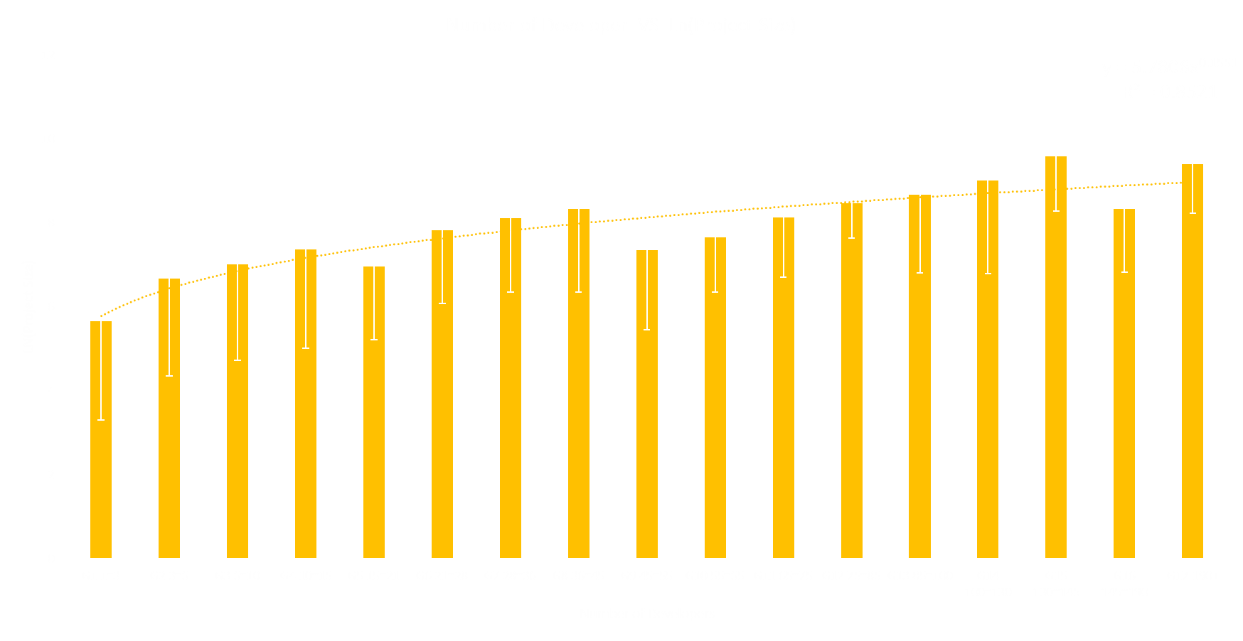
Use this model for rough estimation
Step 1. Estimate the line of code => (X).
Step 2. Get size of project (kB) => X/coefficient=X/25.6
Step 3. Use natural logarithm: Ln(X/25.6) =>(y).
Step 4. Plug (y) into the model trend line
Step 5. Solve for (x).
Step 6. Interpret (x).
Trendline
y = 5.7806x^{0.1551}
Notes:
So how to use this model to make a rough estimation,
First, we need to estimate the lines of code we need for a project, let’s call it BIG X,
Then we need to get the size of project by do the ratio of the BIG X and our coefficient, which is X over twenty five point six.
Then we use natural logarithm on this whole thing and we call it small y.
We plug the small y into the model trend line which shows here,
And then we solve for (x) and interpret it.

Slide 20
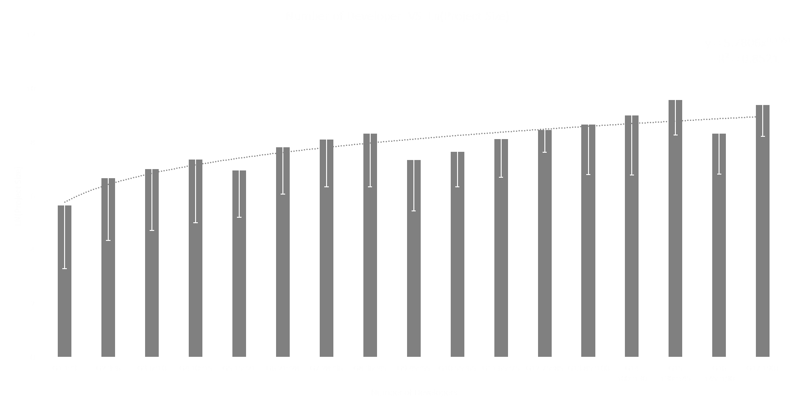
An example
Integer parts: group index among all 17.
Fractional part: exact value in a group
E.g. (x)=8.3
Integer part = 8
=> Group 8 in the graph
=> 36~45 developers
Fractional part = 0.3
0.3*(45-36)=2.7
36+2.7=38.7 (estimate result)
Notes:
I am gonna give an example of interpreting the small (x):
The Integer part of small x indicated which group it would fall into among all 17 groups in the model
And the Fractional part will indicate the exact place it would at in this group.

Slide 21
Limitations(I)
Good at estimating projects that needs 3~85 developers.
Too little: not stable
Too large: not enough data
Can only estimate a quantitative result on GitHub platform
Notes:
I am now going to talk about the limitations,
This model is good at estimate the projects needs 3 to 85 developers, as the highlighted part in this graph,
The data of projects have very few developers are not stable enough, and the data of projects have lots of developers are too less, we didn’t got enough time to collect those data.
Although it shows the relationship between the Number of developers and project size,
it Can only estimate a quantitative result on GitHub platform, this model may not match data from other platform.

Slide 22
Limitations (II)
Relatively small sample sizes.
Impossible to keep track of time contributed by different developers.
Notes:
There are also other limitations,
We are currently using a relatively small sample size due to our limited research time and the technique difficulties we’ve been through.
And It’s impossible to keep track of the time each developer spent on a project, this can potentially effect the accuracy of result.
So that’s the limitations.

Slide 23
Future improvements
1. Increase the sample size
2. Try other time range and platform
Notes:
And for future improvements,
We can improve this study by Adding up the sample size (to at least 10% of all projects we are looking at)
Another interesting dimension would be Trying another time range or platform, (we are currently looking at the projects created between Sep 2016 to Sep 2017 on GitHub) to see if the pattern still matches
Now Lamont will summarize our conclusion.

Slide 24
Table of Contents
Introduction
Method
Result
Discussion
Conclusion

Slide 25
Conclusion
This study found a quantitative formula model of how number of developers influenced the size of projects (y=5.7806 x^ 0.1551).

Slide 26
References
Characters per line. (2018, July 15). Retrieved from https://en.wikipedia.org/wiki/Characters_per_line
GitHub. (2017). GitHub Octoverse 2017 | Highlights from the last twelve months. Retrieved from https://octoverse.github.com/
Krishnamurthy, R., Jacob, V., Radhakrishnan, S., & Dogan, K. (2016). Peripheral developer participation in open source projects: an empirical analysis. ACM Transactions on Management Information Systems (TMIS), 6(4), 14.
Mayhew, S. (2015). open source software. In A Dictionary of Geography. Retrieved from http://www.oxfordreference.com/view/10.1093/acref/9780199680856.001.0001/acref-9780199680856-e-4035
Microsoft. (2018). Choosing the best trendline for your data - Office Support. Retrieved from https://support.office.com/en-us/article/choosing-the-best-trendline-for-your-data-1bb3c9e7-0280-45b5-9ab0-d0c93161daa8
Roberts, J. A., Hann, I. H., & Slaughter, S. A. (2006). Understanding the motivations, participation, and performance of open source software developers: A longitudinal study of the Apache projects. Management science, 52(7), 984-999.

Slide 27
Thanks for watching!!

Slide 30
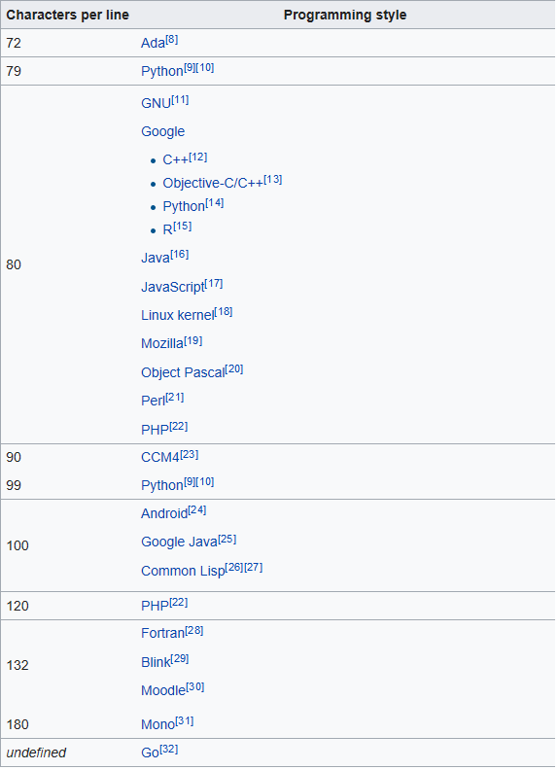
Characters Per Line
Retrieved from https://en.wikipedia.org/wiki/Characters_per_line

Slide 31
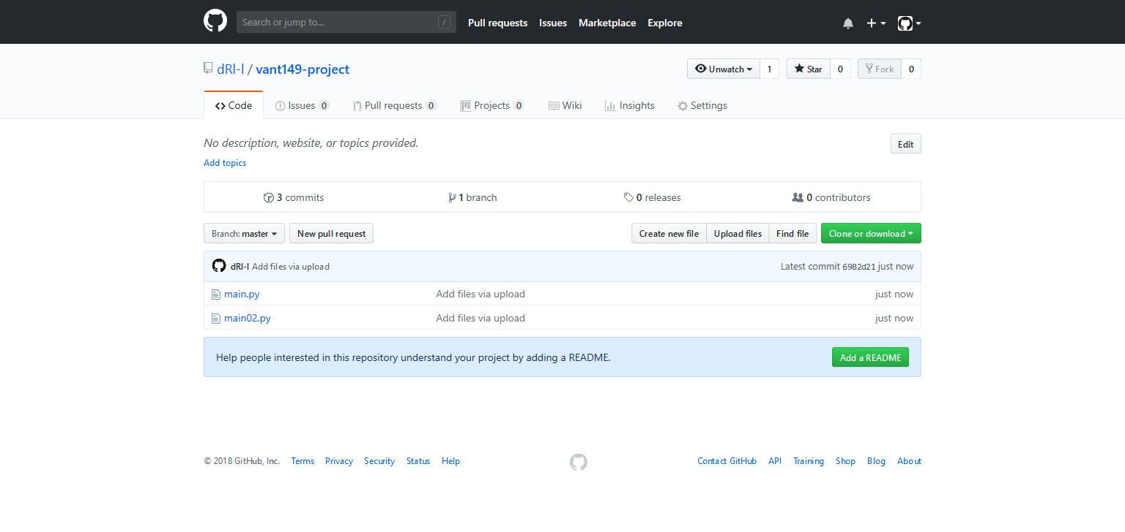
https://github.com/dRl-l/vant149-project

Slide 32
